Slide 1
Make Games
PRESS START

Slide 2
LD48
LUDUMDARE.COM

Slide 3
#25
YOU ARE THE VILLIAN

Slide 4

patient ZERO

Slide 5
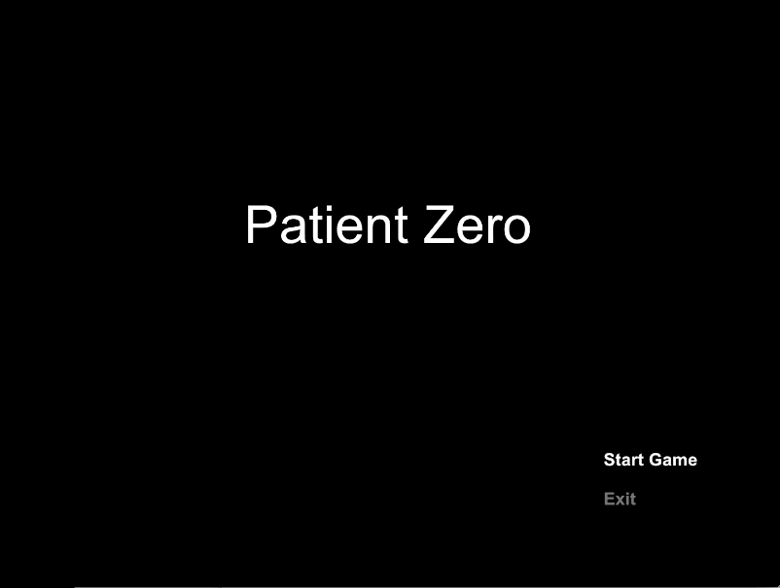

Slide 6
#59 Audio 3.45 #324 Mood 2.86 #403 Theme 3.13 #550 Graphics 2.43 #555 Overall 2.65 #614 Innovation 2.32 #628 Humor 1.79 #640 Fun 2.18
RANKED AGAINST 902 ENTRIES

Slide 7
1 year LATER…

Slide 8

100 UPLOADS
11 “ALBUMS”
COMPOSED MUSIC FOR OTHER GAMES
SOUNDCLOUD

Slide 9

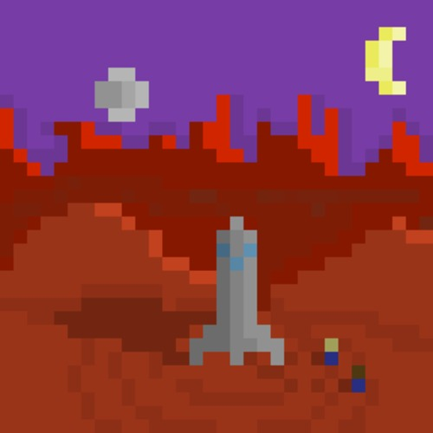
ORDER NOW!!!
SOUNDCLOUD.COM/FRANKLIN-WEBBER

Slide 10
#26
MINIMALISM

Slide 11



Slide 12
Come to me
You are so precious
Please, I’m begging

Slide 13
I never wanted you
I hate you
You're not perfect

Slide 14
DESIRE

Slide 15
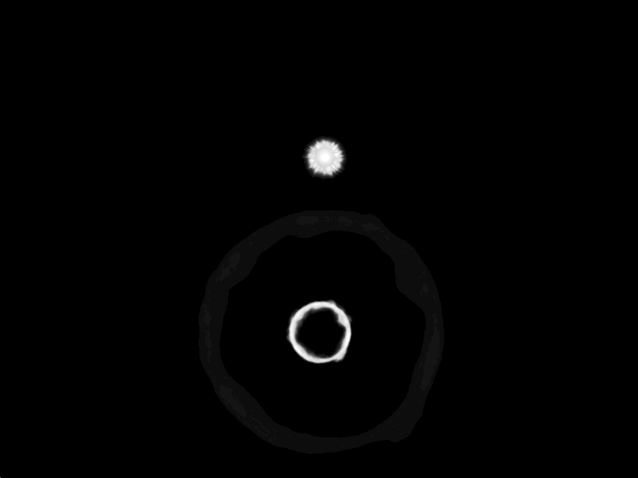

Slide 16
#36 Mood 3.92 #159 Audio 3.41 #249 Theme 3.88 #296 Innovation 3.45 #477 Graphics 3.13 #491 Overall 3.23 #688 Fun 2.83 #839 Humor 1.86
RANKED AGAINST 1608 ENTRIES

Slide 17
1 year LATER…

Slide 18
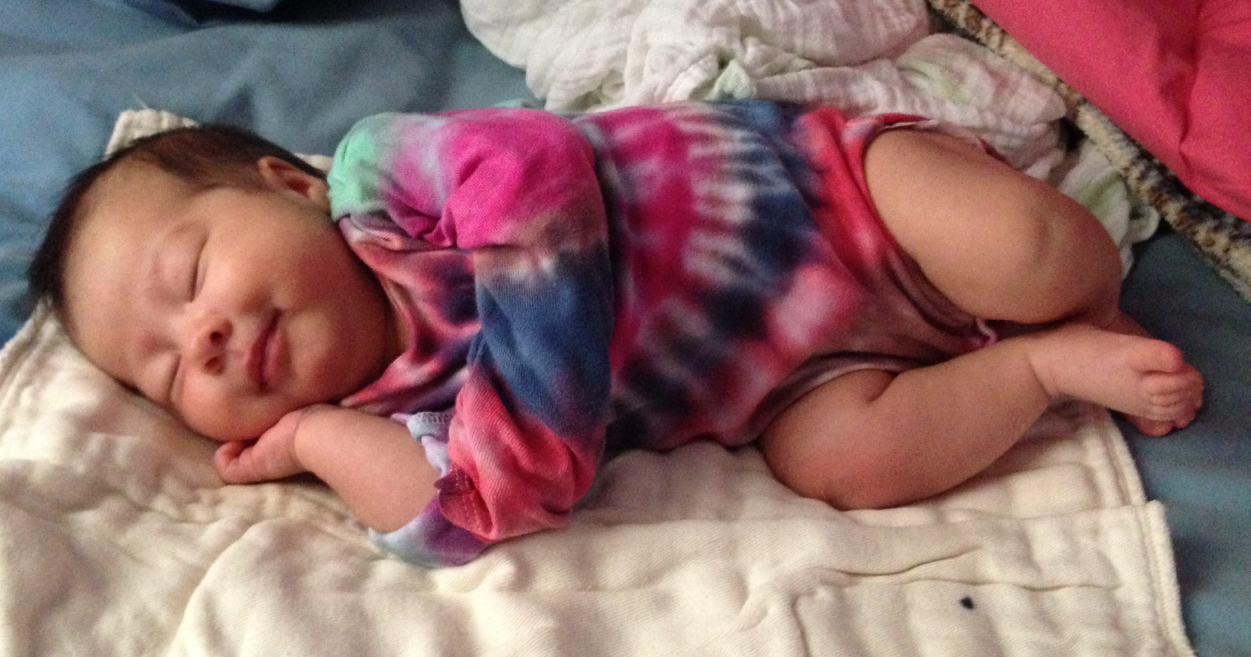
MAZI

Slide 19
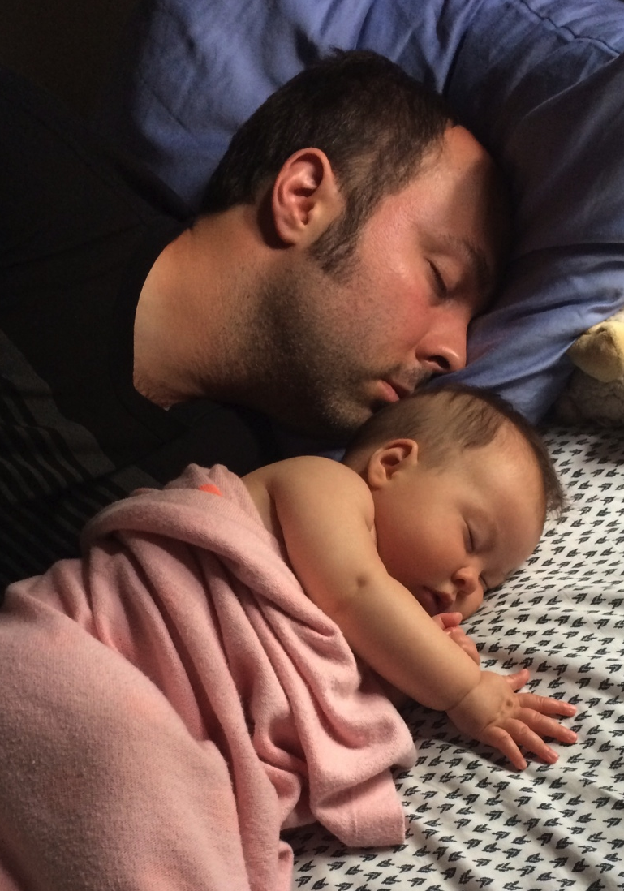
#BREEDER

Slide 20
LD48
LUDUMDARE.COM

Slide 21
all KINDS OF GAMES

Slide 22
CONSTRUCT 2 Game MAKER Studio RPG MAKER Ren’PY STENCYL Torque 2d/3D Unity Unreal ENGINE
GAME ENGINES

Slide 23
FLIXEL Flashpunk GOSU haxeflixel MONOGAME PHASER
GAME FRAMEWORKS

Slide 24
GOSU
LIBGOSU.ORG

Slide 25
GOSU
SLOW
HARD TO RELEASE

Slide 26
GOSU
WHO CARES!

Slide 27
#EC14
@RINPAKU
RIN-RAEUBER.COM

Slide 28
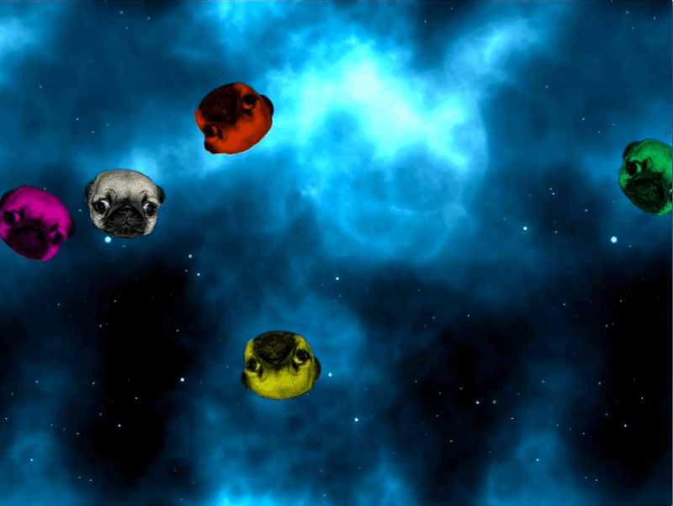

Slide 29
METRO
GEM INSTALL METRO

Slide 30
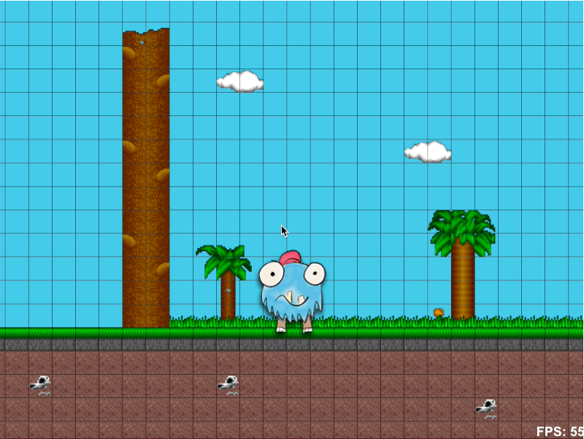

Slide 32
Make Games
THE END!

Slide 33
ORDER NOW!!!
SOUNDCLOUD.COM/FRANKLIN-WEBBER

